Slide 1
Operating System Overview
Major Ideas and Concepts
What If …?
Where Operating Systems Fit
Why We Need Them
Operating System Concept
Operating System Types
Services and Facilities

Slide 2
Major Ideas and Concepts
Need for an operating system
Basic types of services provided by operating systems
Different ways of classifying operating systems
Criteria and methods for evaluating operating systems

Slide 3
Major Ideas and Concepts
Single job and concurrent processing
Batch and online processing
System services and facilities
Types of user interfaces
User services
  Commands
  Application Program Interface - API

Slide 4
What If …?
What would it be like to operate a computer
without the benefit of an operating system?

Slide 5
Where They Fit
Software hierarchy
Software has two main categories:
  Operating Software
  Application Software
Application Software
  General Purpose
  Application Specific
Systems Software
  Application Development
  System Management

Slide 6
Where They Fit
Software
Application
Operating
General
Purpose
Application Specific
System
Management
Application
Development
Operating systems fall here

Slide 7
Why we Need Them
Substantial increases in computing power
Expensive machines were not being fully utilized
CPU was idle while the computer processed large I/O bound jobs
Demand for computing resources was also growing exponentially
Size and complexity was making them increasing more difficult to use
Need to manage these expensive computing resources
Something needed to be done
Solution - let the machine to manage its own resources

Slide 8
Operating System Concept
Definition
“a collection of computer programs that integrate the hardware resources of the computer and make those resources available to the user, in a way that allows the user to access those resources in a productive, timely and efficient manner.” Englander
“an operating system is the computer’s master control program that acts as an intermediary between the user and the computer system and provides resource sharing services.” Dischiave

Slide 9
Operating System Concept
Operating systems provide basic functions:
Accepts and executes commands
  Requests from the user
  User programs
Loads, executes and manages programs
Manages hardware resources

Slide 10
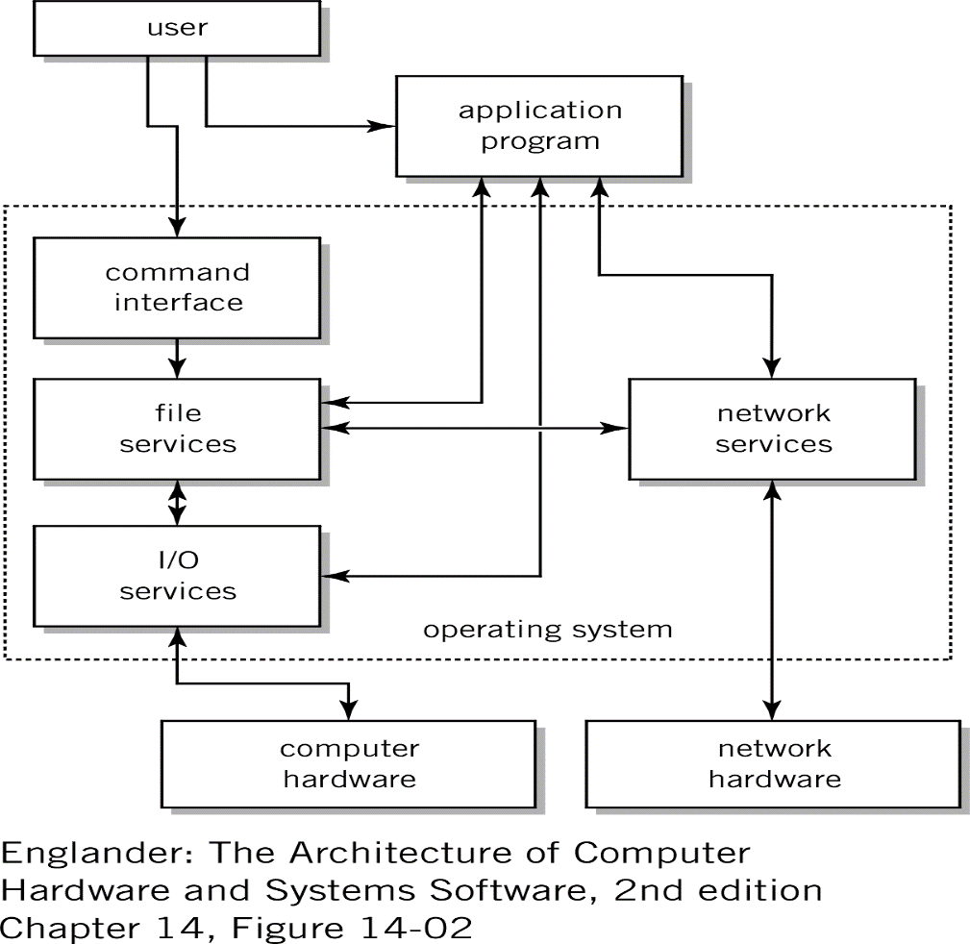
Operating System Concept
Here is the interface point where you you are no longer in control

Slide 11
Operating System Concept
Kernel - resident portion of the operating system
  Operating systems are event driven
  Kernel essentially is idle waiting for a request for service
  Requests can be interrupts for I/O, error handling or service requests
In memory all times while computer is powered on
Kernel has to be available for execution at all times
User interface and interrupt routines need to be always available
Not all of the OS needs to loaded at once
Rarely used functions that can be retrieved as needed
Often called “transient” routines

Slide 12
Operating System Types
Single-user, single-tasking
  One user at a time
  Running only one task at a time
Single-user, multi-tasking
  One user at a time
  But capable of running many tasks at a time
Multi-user, multi-tasking
  Many users sharing the computer
  Each capable of running many tasks at a time

Slide 13
Operating System Types
Single-job Operations
  Far simpler than their Concurrent Operations counterpart
  Mainly due to the amount of work the operating system is expected to do
  Can only support one user and only one task
  User has no capability to enter multiple tasks
  Next task must wait until the current task completes
Concurrent Operations
  Single-job processing is wasteful of system resources
  Programs use an incredibly small amount of CPU resources
  For example:
  Select the Performance tab in the Windows Task Manager, watch the CPU usage graph in the upper left hand corner. You will notice that for the majority of the time, usage will vary from 0 to 4%. So the CPU is loafing more often then doing real work

Slide 14
Facilities and Services
Number of building blocks that provide services
  Command processor, application program interface and user interface
  File management system
  I/O control system
  Process control management, inter-process communication
  Memory management
  Scheduling system
  Secondary storage management
  System protection management
  Network management, communication support, communication interfaces
  System administration support

Slide 15
Facilities and Services
Command processor, application program interface and user interface
Most visible component of the operating system.
Many operating systems it’s actually outside the kernel located in what is referred to as the “shell”
Access the operating system
  User interface - Graphical User Interface or GUI, menu or command line
  Scripting languages - set of commands submitted to the operating system that after submission don’t require user intervention

Slide 16
Facilities and Services
File Management System
Mechanism that provides mapping relationships between a file’s logical storage needs and the physical location where it is actually stored
Provides and maintains the following services:
  Directory structures for each I/O device with the associated tools to access and move these structures around
  Tools that manipulate files. Includes add, move, delete, rename, copy
  Retains statistics about the files. Includes: dates, times, sizes, users, type
  Security mechanisms to protect, control and limit file access

Slide 17
Facilities and Services
Input/Output Services
Implemented through operating system programs called “device drivers”
Provides device drivers for each device installed on the computer
I/O device drivers accept I/O requests and perform the actual data transfer between the I/O device and the specified areas of memory
Device drivers provide services to the file management system
File management needs to be informed so that it can keep track of the file transfer statistics

Slide 18
Facilities and Services
Process Control Management
Process is an executing program regardless of the origin
  From the user
  From operating system itself
Processes consume system resources
Multi-tasking environment programs contend for the same resources
Process control management works with memory management and scheduling
Ensures that processes run unencumbered
Also tracks each process in memory tables

Slide 19
Facilities and Services
Memory Management
Ensures that each program has memory it requires for execution
Memory management main tasks:
  Keeps track of memory and allocates additional memory as needed
  Prevents programs from reading and writing memory outside its allocated space
  Maintains queues of programs waiting to be loaded into memory
  Allocates and de-allocates memory as it becomes available or unavailable for use
Early programming days, programmers were responsible for securing the memory that was required to run the program
Programmers no longer have to worry about memory management now that the operating system takes care of it

Slide 20
Facilities and Services
Scheduling
In multi-tasking, multi-user computing environment
Need to effectively share the computing resources
This is the job of the scheduler
Takes into account the resources required by the task - CPU, memory and I/O devices
Important - scheduler creates an appropriate mix of tasks
So no one task monopolizes the system

Slide 21
Facilities and Services
Secondary Storage Management
Useful in large multitasking environments
Attempt to optimize the completion of I/O tasks
Make more efficient use of disk storage devices
Many programs are requesting I/O services at the same time

Slide 22
Facilities and Services
Security and protection Services
Features that provide protection of the systems resources
Login and password authentication
Protects the kernel and transient operating system programs and files
Protects the address space of each task
Provides access to each resource
But only - one task at a time

Slide 23
Facilities and Services
Network and Communications Support
In distributed computing environments this service is a necessity
Most operating systems allow:
  File transfer
  Remote login capabilities
  Inter-computer process execution

Slide 24
Facilities and Services
System Administration Support
Set of tools called utilities
Used by System Administrators or System Engineers
People that maintain the computer system
Administrative tasks include:
  Configuring the system
  Installing software
  Assigning/maintaining login accounts
  Monitoring performance
  Monitoring security
  Providing file backups
  Cleaning up file space

Slide 25
Next Time
User view of operating Systems

